Slide 1
RMK COLLEGE OF ENGINEERING AND TECHNOLOGY
22CS101 Problem Solving using C++

Slide 2
Pulla Chaitanya 111622201083
Narayanan p 111622201069

Slide 3
Calculator
What can it do?
The calculator we build can do arithmetic operations like addition, subtraction, multiplication and division. It can do trigonometric operations too like arithmetic operations in trigonometry and can even find the trigonometry ratios.
What else it can do?
The calculator we can store the history upto 10 values.
We have add a help function just to tell the user what to do and how to use the calculator.

Slide 4
Language:
C is the language we used here to built this project.
In c we used components like functions, switch, while, for, return, and etc.

Slide 5
Working
The program is first break down into 3 functions ( i.e. main function, arithmetic function and trigonometry function.
Main function:
Main function contain the base code and has the code for history and help.
Arithmetic function:
this contains the code which do the arithmetic operations that is addition to division it is named as art() in the code.

Slide 6
Trigonometric function:
This function contains the code that performs trigonometric calculations. This function is done with the help of header called
Include<math.h>
This header allowed us convert the string into the trigonometry ratios like sin, cos, tan, etc.

Slide 7
Algorithms Or Logic
Main function:
initially the program starts with while loop the condition in the while loop will never become false thus everything will in the loop.
inside the while loop a for loop is initialized this for loop is used for storing history that is the end point of the for loop is the amount of history it can store
(i.e. for(i=0;i<10;i++) in this 10 value can be stored in an array as a history.
inside the for loop there is a scanf statement which get a number.

Slide 8
switch of number is declared. That is if user gave the input as one it means user needs to performs the arithmetic operations , two for trigonometry, three for history and finally four for help.
Art function (arithmetic function)
initially a struct is declared in this function.
struct contains one int and one char.
an array of struct is declared.
using for loop the inputs was claimed from the user.
a switch case is declared for the char that is if the char is “/” it will divide the corresponding value with next value.
switch case is declared for addition and subtraction and multiplication.
after the switch case the value was returned to the main function.

Slide 9
main function displays the output.
Tri function (trigonometry function)

Slide 10
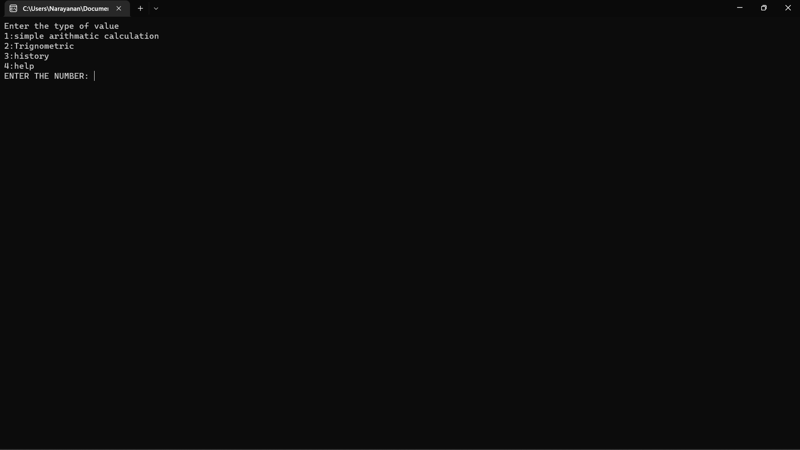

Slide 11
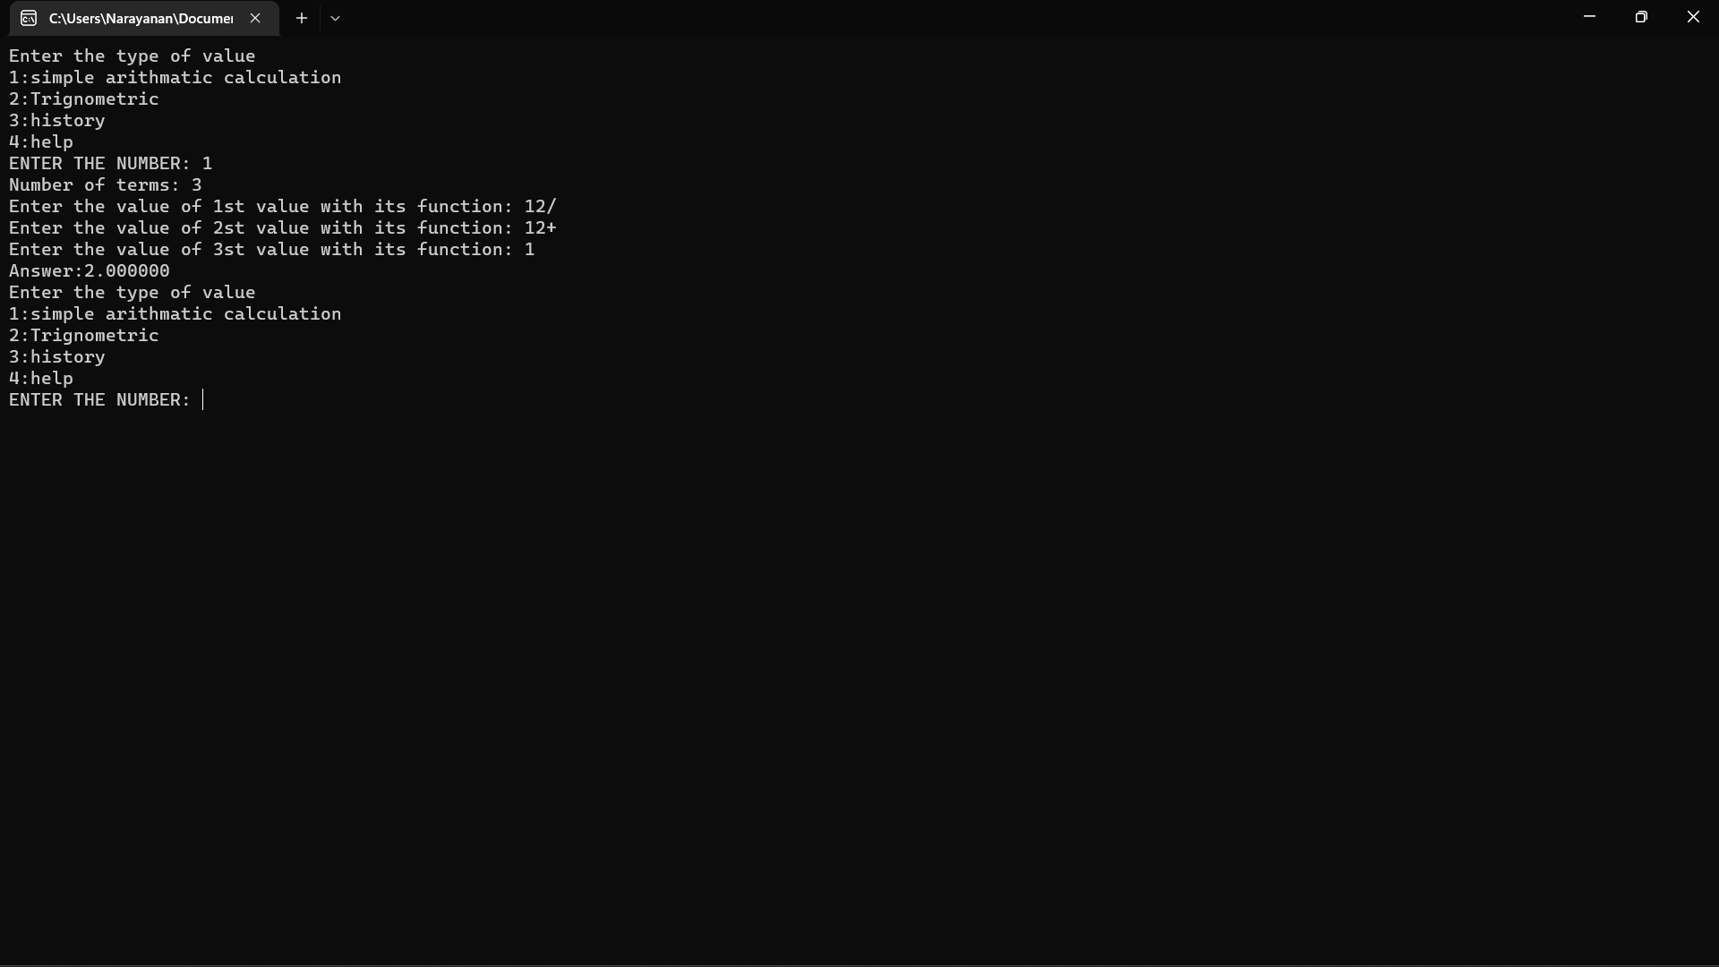

Slide 12
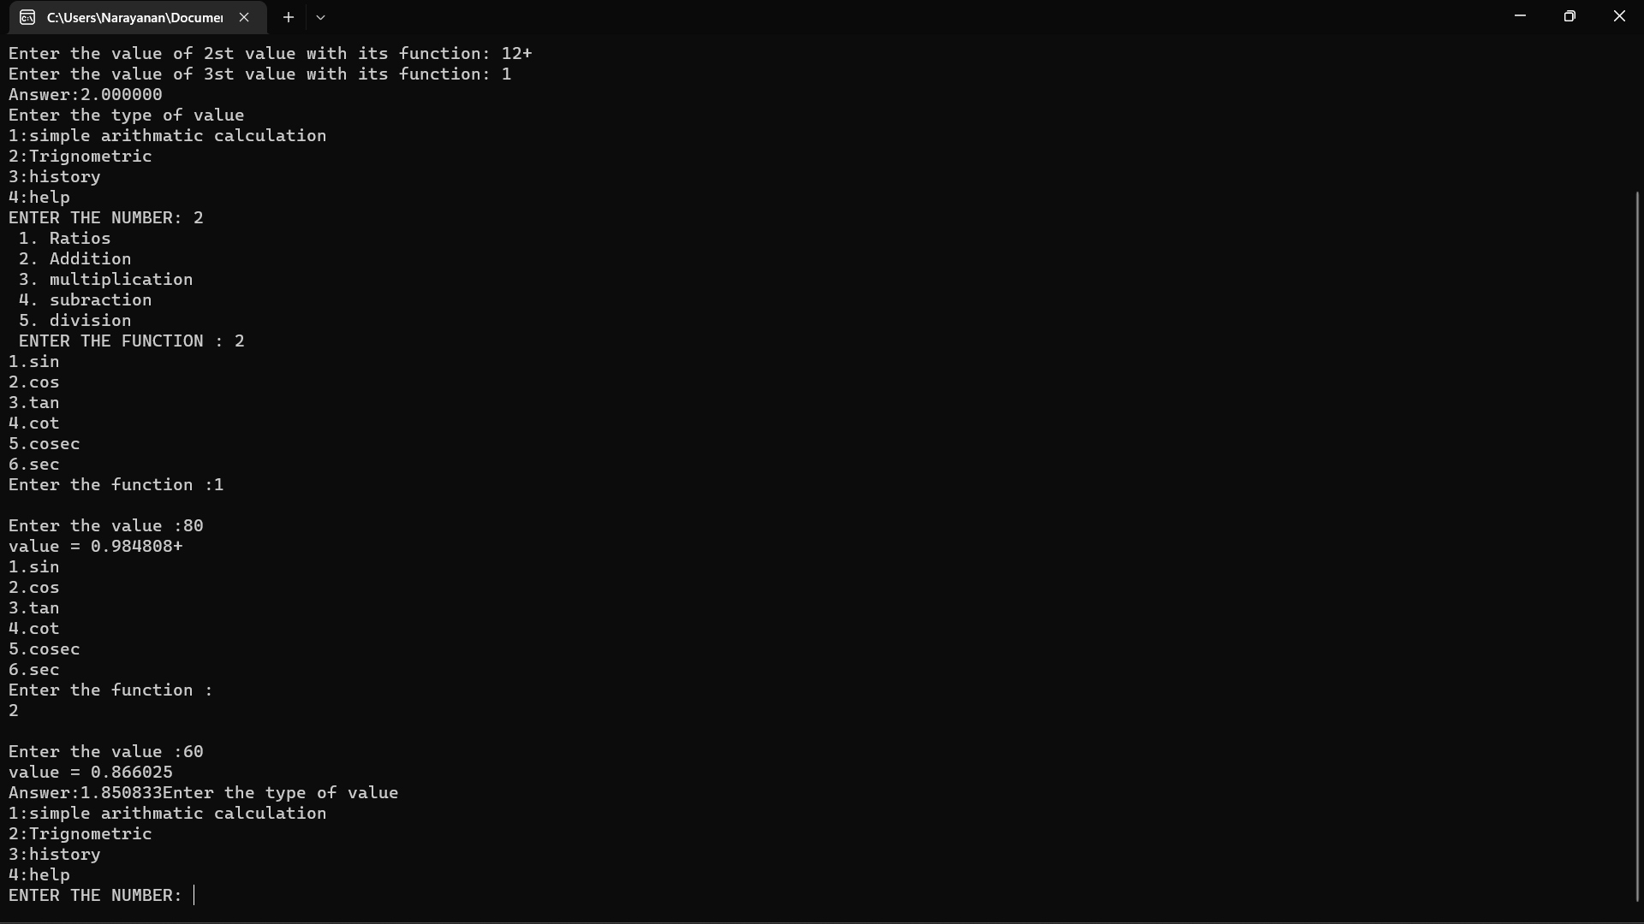

Slide 13
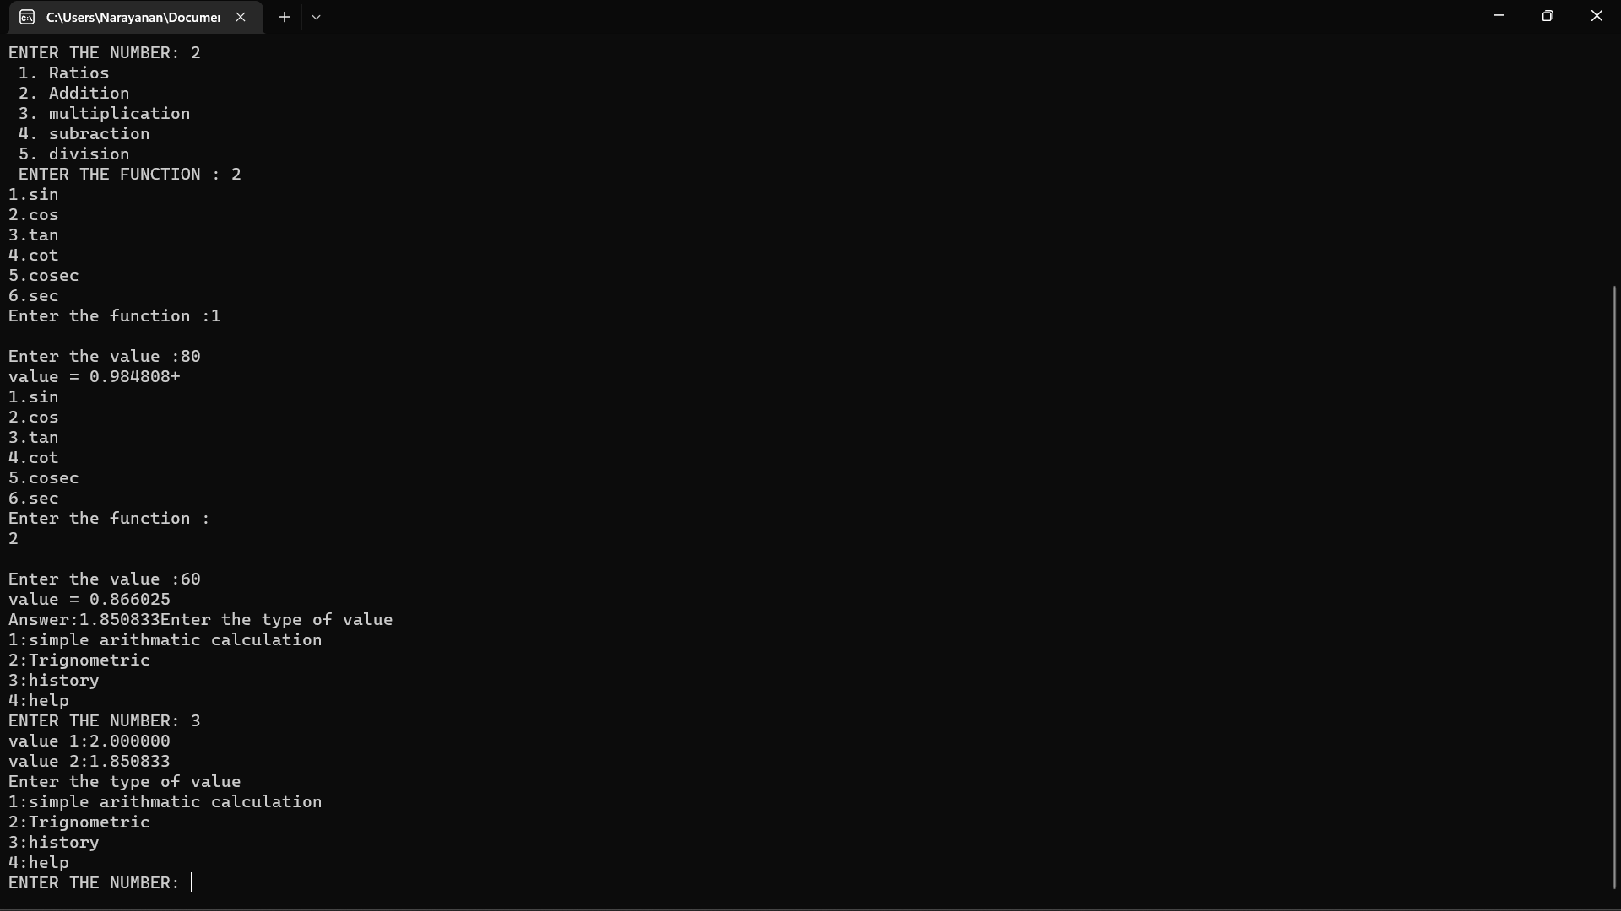

Slide 14
